Slide 1
Pre-order traversal
Pre-order-traversal (root)
If tree is not empty:
Print root->info
Pre-order-traversal (root->left)
Pre-order-traversal (root->right)
1
70
2
3
60
80
LST
RST
1
1
2
3
2
3
30
62
75
92

Slide 2
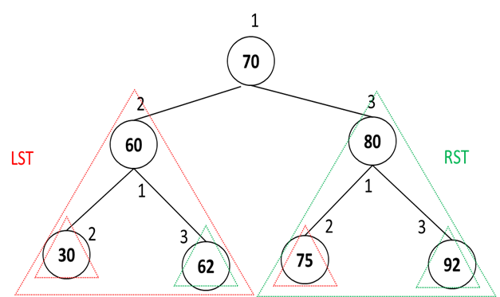
a
b
e
f
g
c
d

Slide 3
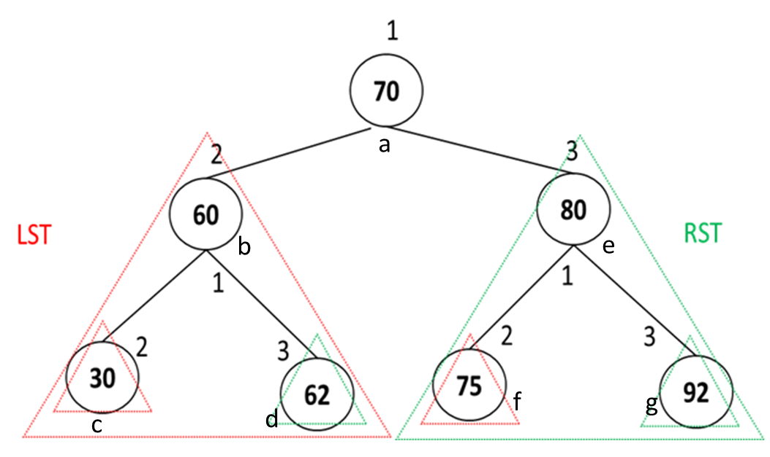
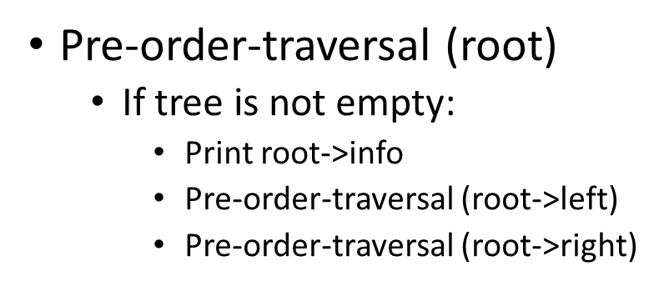
a
Root==a means root !=0
b
e
70, 60, 30,62,
g
c
f
0
0
0
0
0
0
0
0

Slide 4
In-order-traversal (root)//root=a
If tree is not empty://root!=0
In-order-traversal (root->left)//b
Print root->info
In-order-traversal (root->right)
In-order-traversal (root)//root=b
If tree is not empty://root!=0
In-order-traversal (root->left)//c
Print root->info
In-order-traversal (root->right)//d
30, 60, 62, 70
In-order-traversal (root)//root=c
If tree is not empty://root!=0
In-order-traversal (root->left)//0
Print root->info
In-order-traversal (root->right)//0
In-order-traversal (root)//root=d
If tree is not empty://root!=0
In-order-traversal (root->left)//0
Print root->info
In-order-traversal (root->right)//0
In-order-traversal (root)//root=0
If tree is not empty://root!=0
In-order-traversal (root->left)//0
Print root->info
In-order-traversal (root->right)
In-order-traversal (root)//root=0
If tree is not empty://root!=0
In-order-traversal (root->left)//0
Print root->info
In-order-traversal (root->right)
In-order-traversal (root)//root=0
If tree is not empty://root!=0
In-order-traversal (root->left)//0
Print root->info
In-order-traversal (root->right)
In-order-traversal (root)//root=0
If tree is not empty://root!=0
In-order-traversal (root->left)//0
Print root->info
In-order-traversal (root->right)

